Slide 1



AcF 304 Financial Markets
Bond Markets 1:
Term Structure of Interest Rates (part 2)
FM&I Chapter 5
Notes:
If this PowerPoint presentation contains mathematical equations, you may need to check that your computer has the following installed:
1) MathType Plugin
2) Math Player (free versions available)
3) NVDA Reader (free versions available)

Slide 2
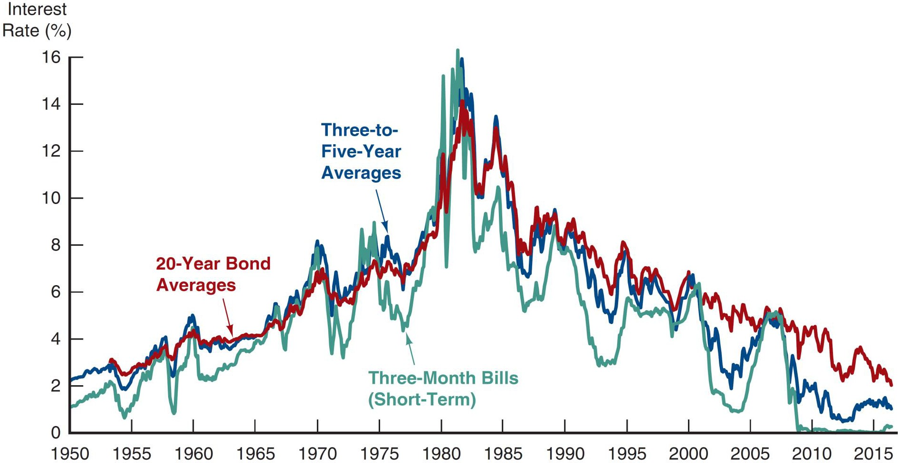

Movements over Time of Interest Rates on U.S. Government Bonds with Different Maturities
Source: Federal Reserve Bank of St. Louis, FRED database, https://fred.stlouisfed.org/series/TB3MS; https://fred.stlouisfed.org/series/GS3; https://fred.stlouisfed.org/series/GS5; https://fred.stlouisfed.org/series/GS20: Yield curve, http://finance.yahoo.com/bonds.

Slide 3
Term Structure Facts to Be Explained
Besides explaining the shape of the yield curve, a good theory must explain why:
Interest rates for different maturities move together.
Yield curves tend to have steep upward slope when short rates are low and a downward slope when short rates are high.
Yield curve is typically upward sloping.

Slide 4
Three Theories of Term Structure
Expectations Theory
Market Segmentation Theory
Liquidity Premium Theory

Slide 5
Expectations theory
Key Assumption: Bonds of different maturities are perfect substitutes
The interest rate on a long-term bond will equal an average of the short-term interest rates that people expect to occur over the life of the long-term bond.

Slide 6
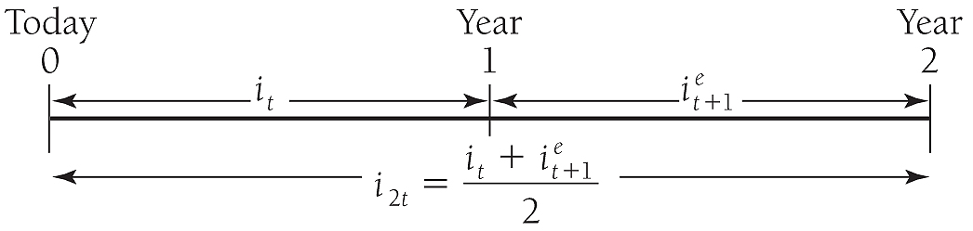
Expectations theory
To illustrate what this means, consider two alternative investment strategies for a two-year time horizon.
Buy a one-year bond, and when it matures, buy another one-year bond with your money.
Buy a two-year bond and hold it.

Slide 7
Numerical example
One-year interest rate over the next five years are expected to be 5%, 6%, 7%, 8%, and 9%
Interest rate on two-year bond today:
Interest rate for five-year bond today:
Interest rate for one- to five-year bonds today: 5%, 5.5%, 6%, 6.5% and 7%

Slide 8
Expectations Theory and Term Structure Facts
Pure expectations theory explains fact 1—that short and long rates move together
Short rate rises are persistent
If
today,
etc.
average of future rates
Therefore:
(i.e., short and long rates move
together)

Slide 9
Expectations Theory and Term Structure Facts
Explains fact 2—that yield curves tend to have steep slope when short rates are low and downward slope when short rates are high
When short rates are low, they are expected to rise to normal level, and long rate = average of future short rates which will be well above today’s short rate; yield curve will have steep upward slope.
When short rates are high, they will be expected to fall in future, and long rate will be below current short rate; yield curve will have downward slope.

Slide 10
Expectations Theory and Term Structure Facts
Doesn’t explain fact 3—that yield curve usually has upward slope
Short rates are as likely to fall in future as rise, so average of expected future short rates will not usually be higher than current short rate: therefore, yield curve will not usually slope upward.

Slide 11
Market Segmentation Theory
Key Assumption: Bonds of different maturities are not substitutes at all
Implication: Markets are completely segmented; interest rate at each maturity are determined separately

Slide 12
Market Segmentation Theory
Explains fact 3—that yield curve is usually upward sloping
People typically prefer short holding periods and thus have higher demand for short-term bonds, which have higher prices and lower interest rates than long bonds
Does not explain fact 1or fact 2 because it assumes long-term and short-term rates are determined independently.

Slide 13
Liquidity Premium Theory
Key Assumption: Bonds of different maturities are substitutes, but are not perfect substitutes
Implication: Modifies Pure Expectations Theory with features of Market Segmentation Theory
Investors prefer short-term rather than long-term bonds. This implies that investors must be paid positive liquidity premium, to hold long term bonds.

Slide 14
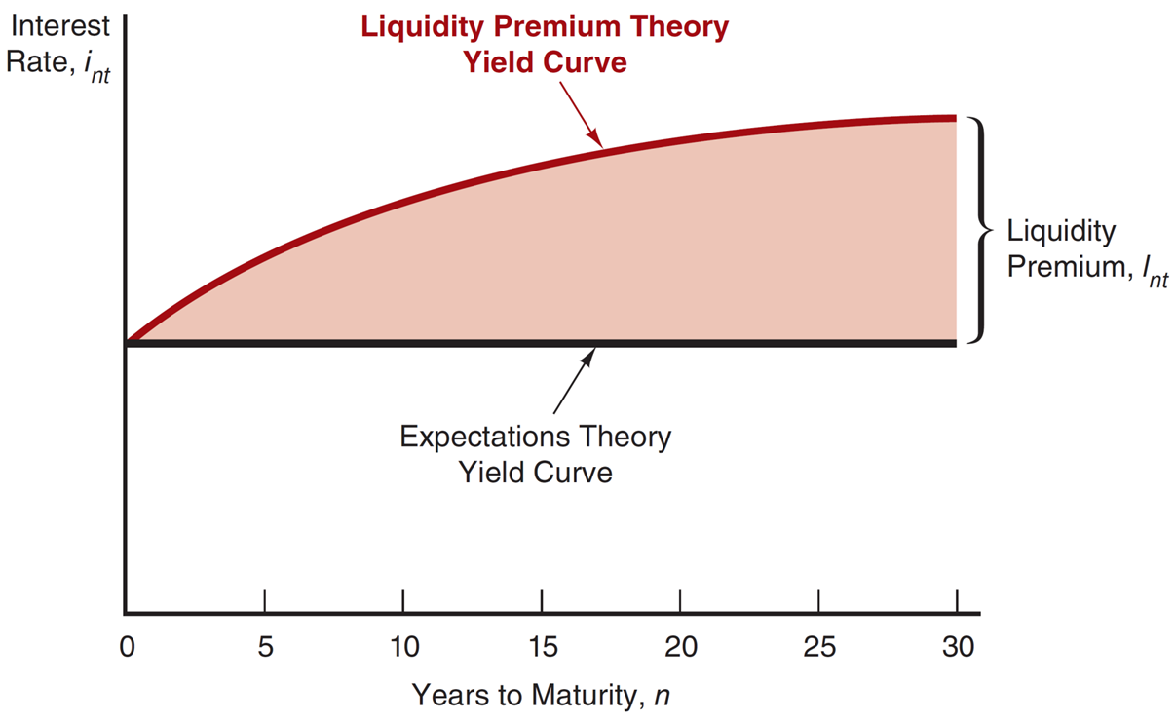
Figure 5.5 The Relationship Between the Liquidity Premium and Expectations Theories
Notes:
The vertical axis is labeled, Interest Rate, i sub n t. The horizontal axis is labeled, Years to Maturity, n and ranges from 0 to 30 in increments of 5. A horizontal line from the middle of the vertical line is labeled, Expectations Theory Yield Curve. An upward sloping curve above this horizontal line is labeled, Liquidity Premium Theory Yield Curve. The area between the horizontal line and curve is shaded and labeled, Liquidity Premium, I sub n t.

Slide 15
Numerical Example
One-year interest rate over the next five years: 5%, 6%, 7%, 8%, and 9%
Investors’ preferences for holding short-term bonds so liquidity premium for one- to five-year bonds: 0%, 0.25%, 0.5%, 0.75%, and 1.0%

Slide 16
Numerical Example
Interest rate on the two-year bond:
Interest rate on the five-year bond:
Interest rates on one to five-year bonds: 5%, 5.75%, 6.5%, 7.25%, and 8%
Comparing with those for the pure expectations theory, liquidity premium theory produces yield curves more steeply upward sloped.

Slide 17
Liquidity Premium Theory: Term Structure Facts
Explains All 3 Facts
Explains fact 3—that usual upward sloped yield curve by liquidity premium for long-term bonds
Explains fact 1 and fact 2 using same explanations as pure expectations theory because it has average of future short rates as determinant of long rate

Slide 18
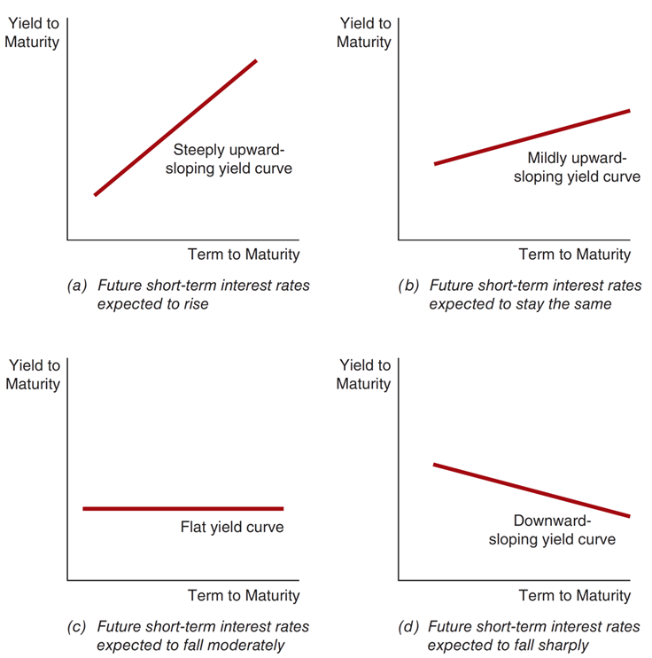
Yield Curves and the Market’s Expectations of Future Short-Term Interest Rates According to the Liquidity Premium Theory
Notes:
The vertical axis of each graph is labeled, Yield to Maturity, and the horizontal axis is labeled, Term to Maturity.
The first graph shows future short-term interest rates expected to rise depicted by a steeply upward sloping yield curve.
The second graph shows future short-term interest rates expected to stay the same depicted by a mildly upward sloping yield curve.
The third graph shows future short-term interest rates expected to fall moderately depicted by a flat yield curve.
The fourth graph shows future short-term interest rates expected to fall sharply depicted by a downward sloping yield curve.

Slide 19

Financial Markets and Institutions
Ninth Edition, Global Edition
Reading – Chapter 5 – How do Risk and Term Structure Affect Interest Rates
Notes:
If this PowerPoint presentation contains mathematical equations, you may need to check that your computer has the following installed:
1) MathType Plugin
2) Math Player (free versions available)
3) NVDA Reader (free versions available)

